Slide 1
VAT Management System
Using C Programming
Created by:
- Ashok Rimal
- Abishekh Nepal
Shishir Pandey
Rajan Gaire

Slide 2
Introduction
VAT Management System is a powerful tool businesses use to manage their Value Added Tax (VAT) responsibilities.
It is a software application that helps businesses to calculate, track, and report VAT.
It can also help businesses to comply with VAT regulations.

Slide 3
List Of Some Features
Accurate VAT Calculation
Efficient Record-Keeping
Real-time Tracking
Automated Reminders
Tax Reporting

Slide 4
Objectives
Ensure accurate and timely calculation of VAT.
Track VAT payable and receivable, input and output VAT.
Generate VAT reports, such as VAT returns and VAT registers.
Automate the VAT management process, saving businesses time and money.
Help businesses to make better decisions about their VAT management.

Slide 5
Limitations
The calculation of value added at every stage is not an easy task.
Technical issues, such as software bugs or hardware failures can cause errors on the VAT records.
VAT Management Systems can be expensive to implement and maintain.
VAT calculation systems may not be able to handle all types of VAT transactions.

Slide 6
0-Level: Data Flow Diagram
VAT Management System
File i.e.
Svat.dat,pvat.dat
Admin

Slide 7
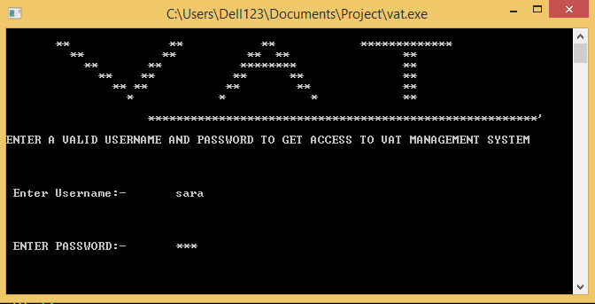
INTERFACE
LOGIN MENU

Slide 8
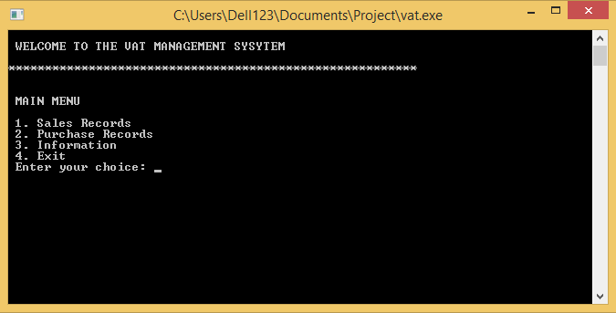
MAIN MENU

Slide 9
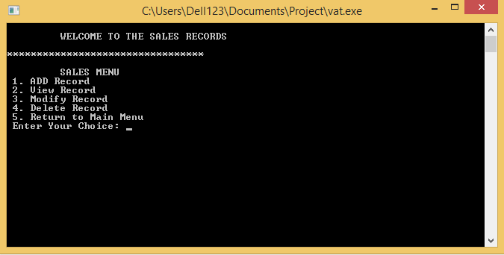
SALES MENU

Slide 10
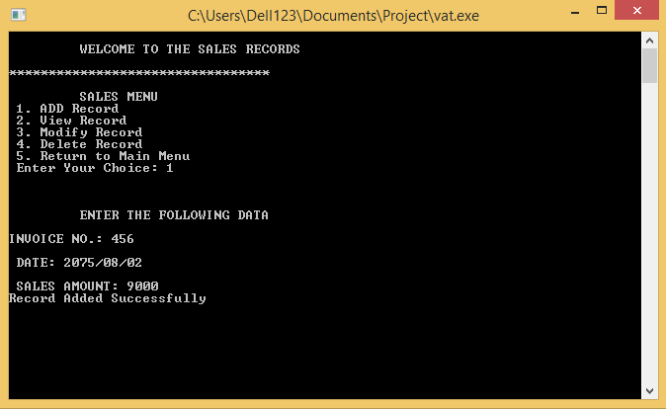
ADD SALES RECORD

Slide 11
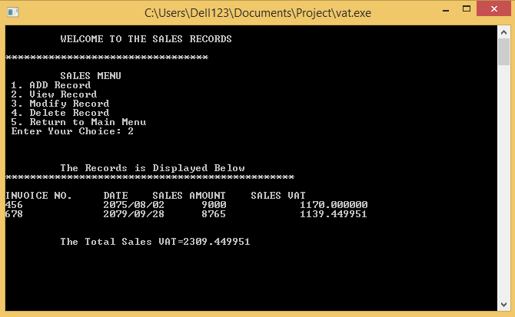
VIEW SALES RECORD

Slide 12
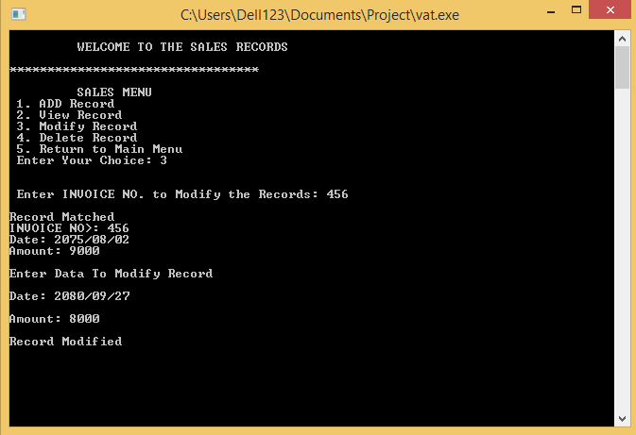
MODIFY ADDED SALES RECORD

Slide 13
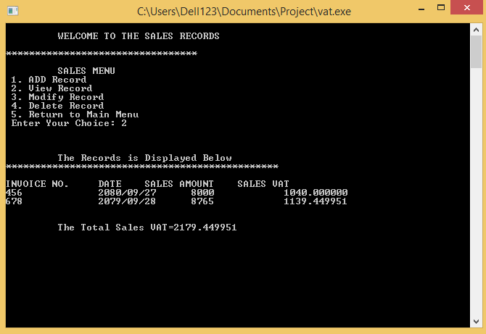
VIEW SALES RECORD AFTER MODIFIED

Slide 14
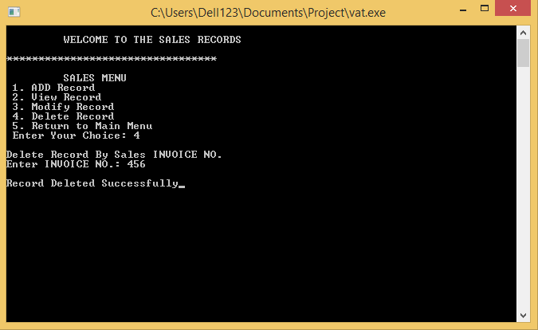
DELETE SALES RECORD

Slide 15
Case Study:
How Organizations got benefited from using a VAT Management System?
Before Using The “VAT Measurement System”,
The organizations were using a manual billing system. This was inefficient and time-consuming, and it often led to errors while recording data .
After Implementing The “VAT Measurement System”,
Businesses can saw a number of benefits:
The billing process became much more efficient, and errors were reduced.
It can help them to make informed business decisions.
The organizations were able to track its sales and inventory more effectively.

Slide 16
Conclusion
At last we conclude that system has overcome the limitation of handling the task of VAT MEASUREMENT System. This system has made it easier to record the details and calculate the VAT bills of the costumer in easier and convenient manner. This program can handle the task in more effective way.

Slide 17
THANK YOU !

